Slide 1
INFO-3142
Lists Tuples and Sets

Slide 2
Lists are Like Arrays
A list in Python is much the same thing as an array in Java or C or any other language; it’s an ordered collection of objects
You create a list by enclosing a comma-separated list of elements in square brackets:
x = [2, "two", [1, 2, 3]]
print(len(x))
#3

Slide 3
List Indices
Elements can be extracted from a Python list by using a notation like C’s array indexing
Like C and many other languages, Python starts counting from 0; asking for element 0 returns the first element of the list, asking for element 1 returns the second element, etc.
But Python indexing is more flexible than C indexing
If indices are negative numbers, they indicate positions counting from the end of the list, with –1 being the last position in the list, –2 being the second-to-last position, etc.

Slide 4
Modifying Lists
You can use list index notation to modify a list as well as to extract an element from it
Put the index on the left side of the assignment operator
x = [1, 2, 3, 4]
x[1] = "two"
print(x)
#[1, 'two', 3, 4]

Slide 5
Modifying Lists
Slice notation can be used here too
Saying something like lista[index1:index2] = listb causes all elements of lista between index1 and index2 to be replaced by the elements in listb
listb can have more or fewer elements than are removed from lista, in which case the length of lista is altered
x = [1, 2, 3, 4]
x[len(x):] = [5, 6, 7]
print(x)
#[1, 2, 3, 4, 5, 6, 7]

Slide 6
Modifying Lists
x[:0] = [-1, 0]
print(x)
#[-1, 0, 1, 2, 3, 4, 5, 6, 7]
x[1:-1] = []
print(x)
#[-1, 7]
x = [1, 2, 3]
x.append("four")
print(x)
#[1, 2, 3, 'four']

Slide 7
Sorting Lists
x = [3, 8, 4, 0, 2, 1]
x.sort()
print(x)
#[0, 1, 2, 3, 4, 8]
x = [2, 4, 1, 3]
y = x[:]
y.sort()
print(y)
#[1, 2, 3, 4]
print(x)
#[2, 4, 1, 3]

Slide 8
Custom Sorting
To use custom sorting, you need to be able to define functions—something not yet talked about:
def compare_num_of_chars(string1):
return len(string1)
def compare_num_of_chars(string1):
return len(string1)

Slide 9
Custom Sorting
word_list = ['Python', 'is', 'better', 'than', 'C']
word_list.sort()
print(word_list)
#['C', 'Python', 'better', 'is', 'than']
word_list = ['Python', 'is', 'better', 'than', 'C']
word_list.sort(key=compare_num_of_chars)
print(word_list)
#['C', 'is', 'than', 'Python', 'better']

Slide 10
The sorted() function
Lists have a built-in method to sort themselves, but other iterables in Python, such as the keys of a dictionary, don’t have a sort method
Python also has the built-in function sorted(), which returns a sorted list from any iterable
sorted() uses the same key and reverse parameters as the sort method:

Slide 11
Other Common List Operations
List membership with the in operator
List concatenation with the + operator
List initialization with the * operator
List minimum or maximum with min and max
List search with index
List matches with count
… see code examples

Slide 12
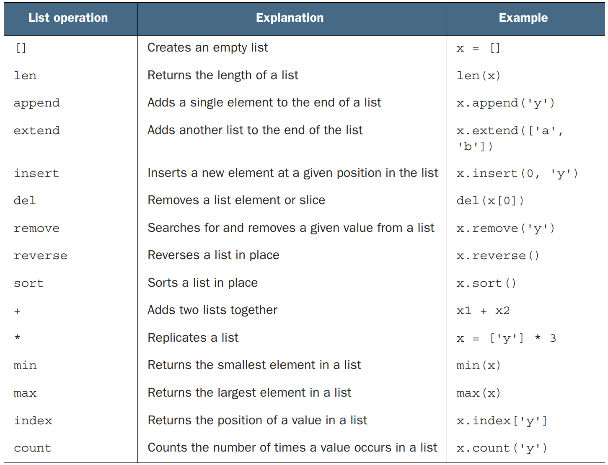
Summary of List Operations

Slide 13
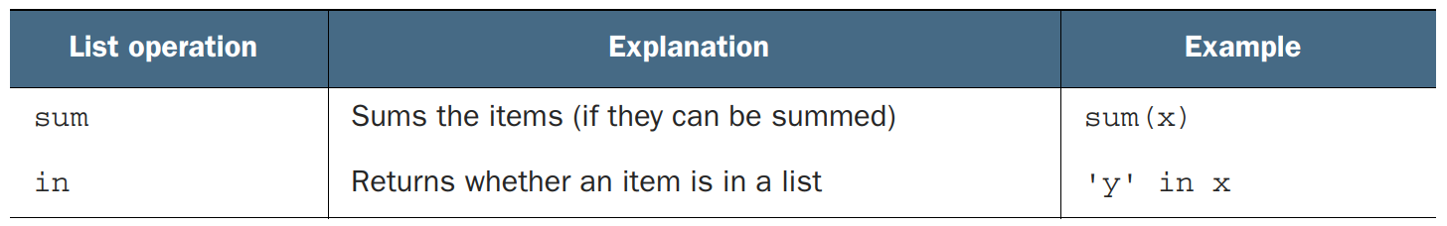
Summary of List Operations…

Slide 14
Tuples
Tuples are data structures that are very similar to lists, but they can’t be modified; they can only be created
Tuples are so much like lists that you may wonder why Python bothers to include them
The reason is that tuples have important roles that can’t be efficiently filled by lists, such as keys for dictionaries

Slide 15
Tuple Basics
x = ('a', 'b', 'c')
print(x[2])
#'c'
print(x[1:])
#('b', 'c')
print(len(x))
#3
print(max(x))
#'c'
print(min(x))
#'a'
print(5 in x)
#False
print(5 not in x)
#True

Slide 16
One-element Tuples
x = 3
y = 4
print((x + y)) # This adds x and y
#7
print((x + y,)) # Including a comma indicates the parentheses denote a tuple.
#(7,)
print(()) # To create an empty tuple, use an empty pair of parentheses.
()

Slide 17
Packing and Unpacking Tuples
As a convenience, Python permits tuples to appear on the left side of an assignment operator, in which case variables in the tuple receive the corresponding values from the tuple on the right side of the assignment operator
(one, two, three, four) = (1, 2, 3, 4)
print(one)
#1
print(two)
#2
one, two, three, four = 1, 2, 3, 4

Slide 18
Converting Between Lists and Tuples
Tuples can be easily converted to lists with the list function, which takes any sequence as an argument and produces a new list with the same elements as the original sequence
Similarly, lists can be converted to tuples with the tuple function, which does the same thing but produces a new tuple instead of a new list print(list((1, 2, 3, 4)))
#[1, 2, 3, 4]
print(tuple([1, 2, 3, 4]))
#(1, 2, 3, 4)
print(list("Hello"))
#['H', 'e', 'l', 'l', 'o']

Slide 19
Sets
A set in Python is an unordered collection of objects used when membership and uniqueness in the set are the main things you need to know about that object
The items in a set must be immutable and hashable
This means that ints, floats, strings, and tuples can be members of a set, but lists, dictionaries, and sets themselves can’t x = set([1, 2, 3, 1, 3, 5])
print(x)
#{1, 2, 3, 5}
x.add(6)
print(x)
#{1, 2, 3, 5, 6}

Slide 20
Frozensets
Because sets aren’t immutable and hashable, they can’t belong to other sets
To remedy that situation, Python has another set type, frozenset, which is just like a set but can’t be changed after creation
Because frozensets are immutable and hashable, they can be members of other sets
x = set([1, 2, 3, 1, 3, 5])
z = frozenset(x)
print(z)
frozenset({1, 2, 3, 5})

